Slide 1


Deep learning for quantum chemistry using density functional tight-binding method - Raghav Arora Supervisors: Dr. Alexandre Tkatchenko¹ Dr. Ram Kinkar Roy² Under the guidance of: Dr. Leonardo Medrano Sandonas¹ ¹- Department of Physics and Material Science, University of Luxembourg, Luxembourg ² – Department of Chemistry, BITS Pilani, India

Slide 2
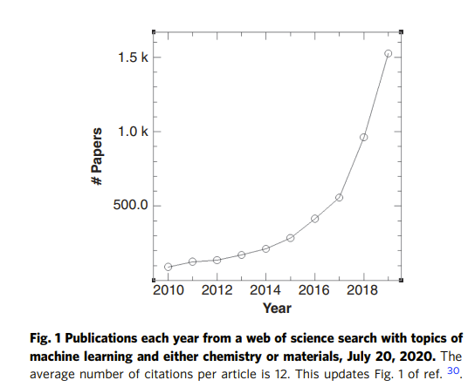
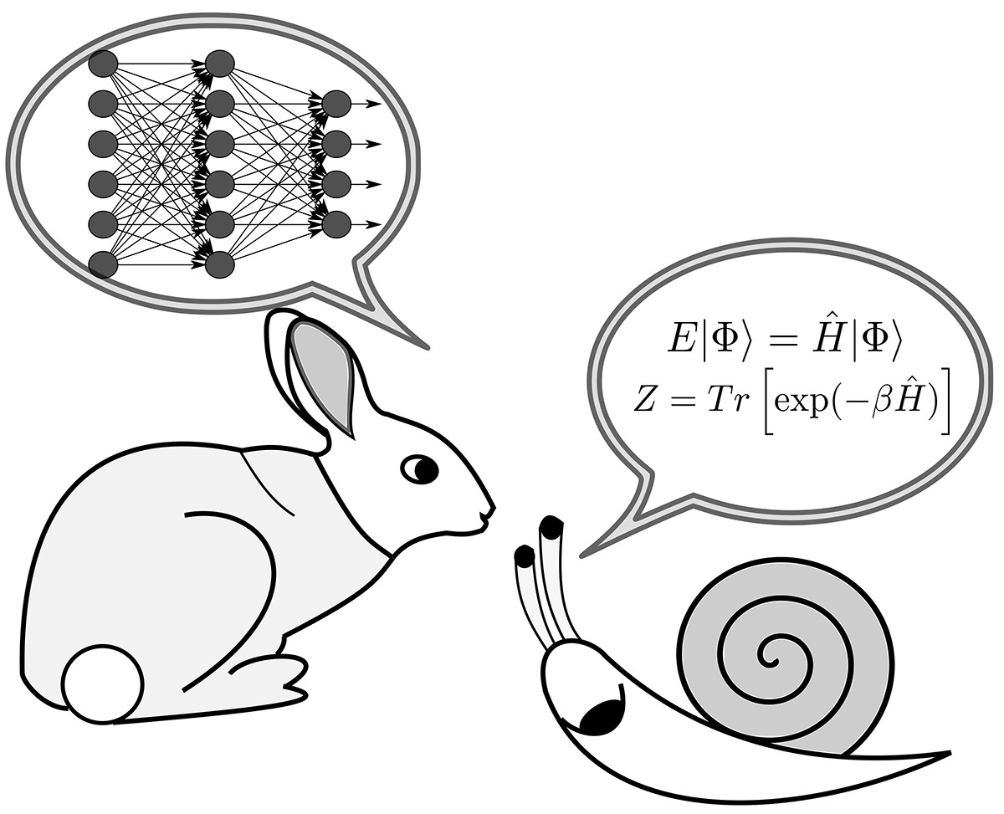
Introduction
Traditional chemical methods for discovery and characterization of compounds are
Time-consuming
Costly
Computational Chemistry methods:​
Design and analyse molecules virtually using simulations and quantum-chemical methods.​
von Lilienfeld, O., & Burke, K. (2020). Nature Communications, 11(1). doi: 10.1038/s41467-020-18556-9

Slide 3
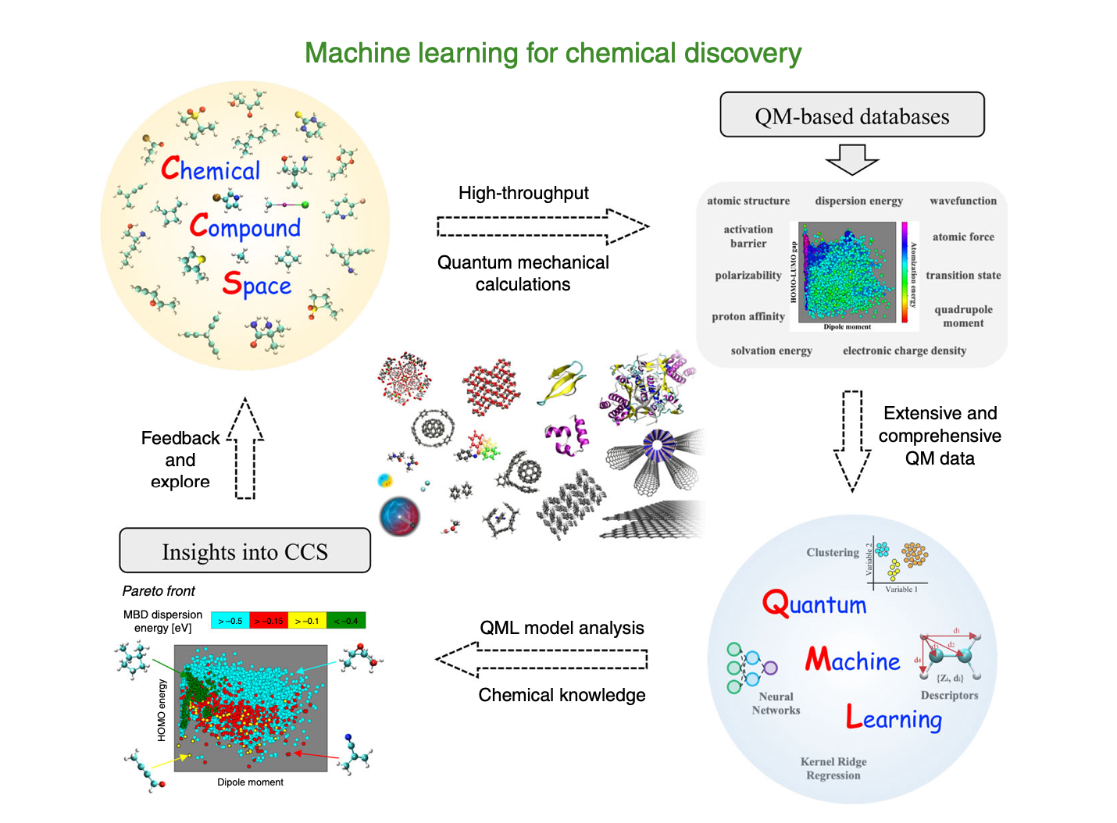
Introduction
Challenges in the use of Machine Learning:
Neural Networks- Black Box
Difficult to know the best method for a particular application
Quality of Dataset influences the results

Slide 4
Introduction
Research Areas involving QML
Computational design and discovery of molecules
Molecular Dynamics Simulations
Obtaining efficient force fields
Creation of datasets of molecular structures and properties
Extending the Chemical compound space
Property Prediction
Molecular Dynamics – gives an estimate of the thermodynamic and kinetic properties – accurate only around the equilibrium
Force fields based on solutions to the SE – Time consuming
QML – Quantum Machine Learning
QM simulations (Kohn Sham DFT) – Too time consuming – not too practical

Slide 5
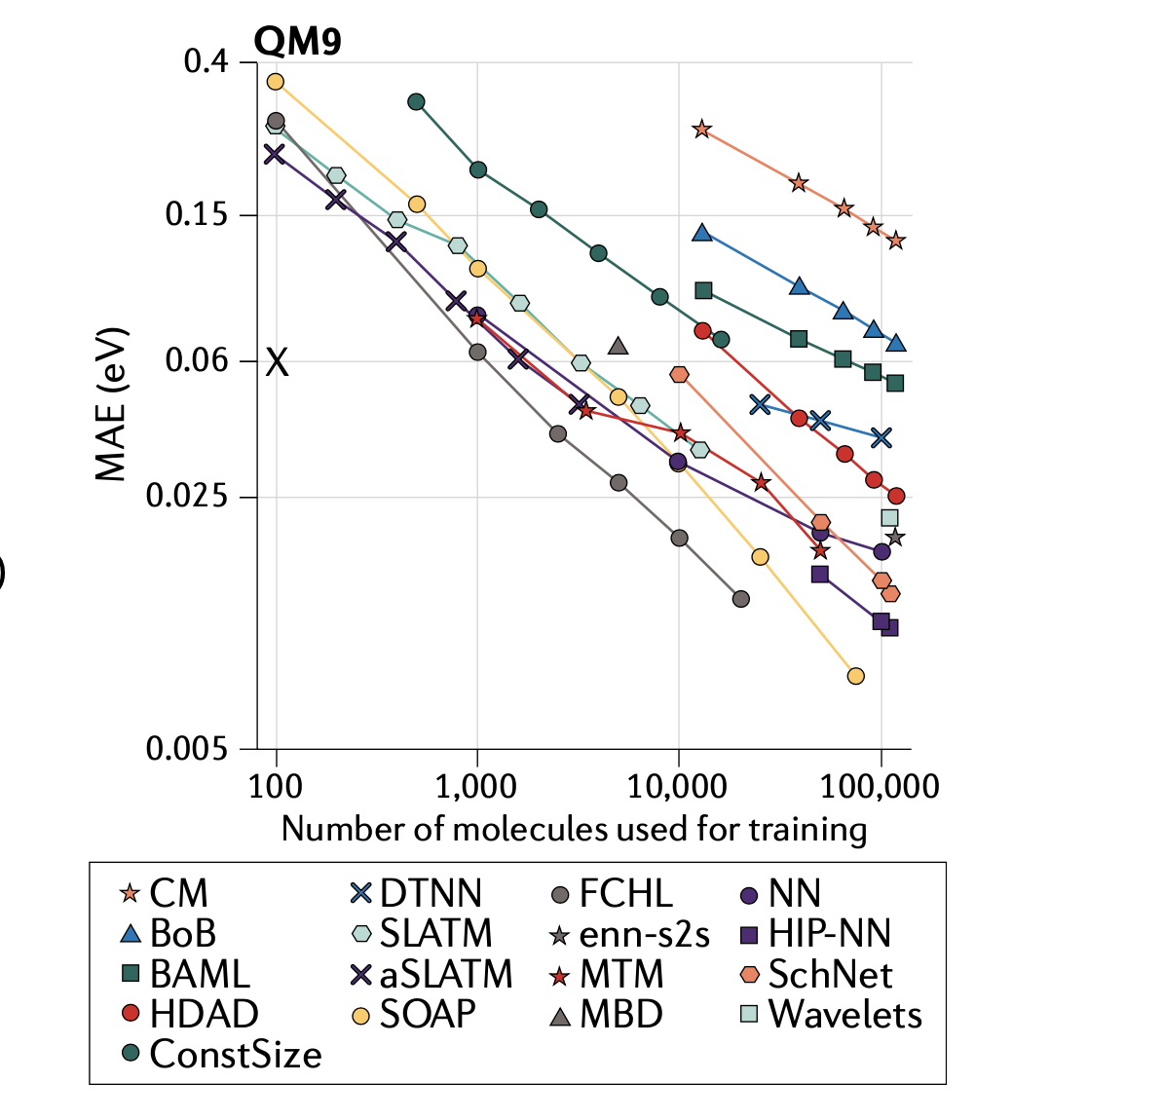
QML to explore CCS
The progress of QML models of atomization energies of molecules over the past few years.
QML prediction errors have decreased by 40—fold – from 8 kcal/mol to 0.2 kcal/mol in 2018 using exactly the same training.¹
Goal of the Thesis:
Property Prediction using Neural Networks, making use of geometric descriptors along with relevant DFTB properties
¹von Lilienfeld, O., Müller, K. and Tkatchenko, A., 2020. Nature Reviews Chemistry, 4(7), pp.347-358.

Slide 6
Methods

Slide 7
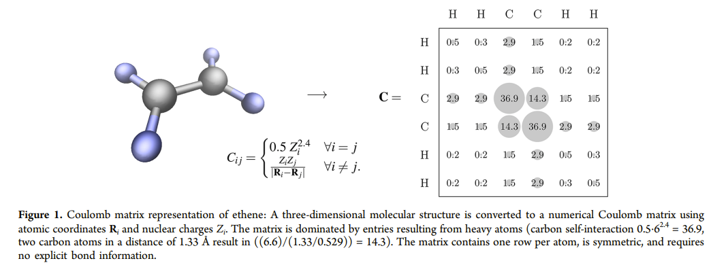
Representation of Molecules - Geometric Descriptors
Geometric Descriptors considered:
Coulomb Matrix
Bag of Bonds: an extension to the Coulomb matrix
SLATM

Slide 8
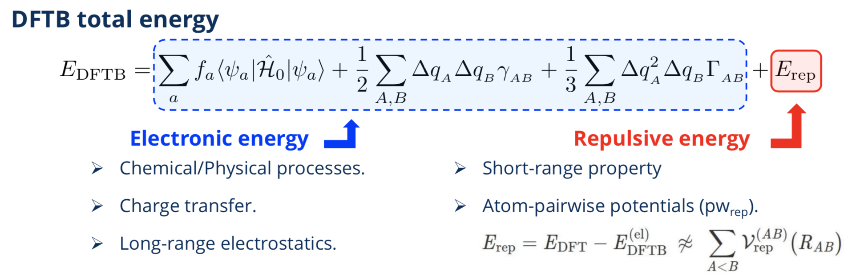
Density Functional Tight Binding Approximation
n(r) = n₀(r) + ∂n(r)
n(r) that minimizes the energy is the ground state density.

Slide 9
Machine Learning Methods
Using Efficient Coulomb Matrices and tight-binding properties as inputs, machine learning models can be implemented for property prediction
Fermi Energy,
Band Energy,
Number of Electron,
H0Ene – 0th DFTB Energy,
SccEne – Second DFTB Energy,
3rdEne – 3rd DFTB Energy,
Repulsive Energy,
mbdEne,
Tbdip – Dipole Moment,
Tbeig – Eigen Value,
TBchg – Electronic Charge

Slide 10
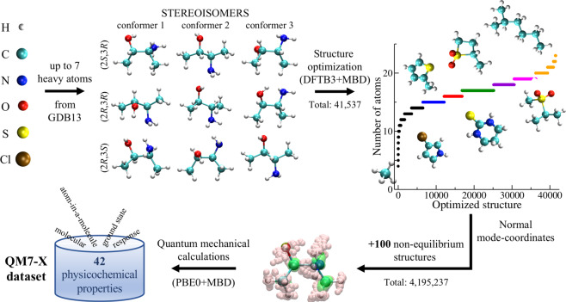
Methodology – Data Preparation
The DFTB properties and geometric descriptors were calculated using the QM7-x dataset

Slide 11
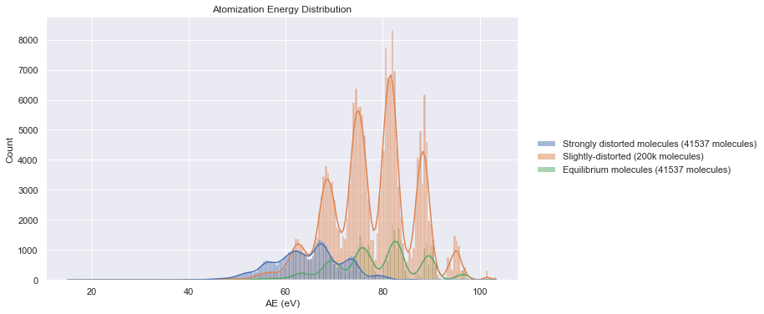
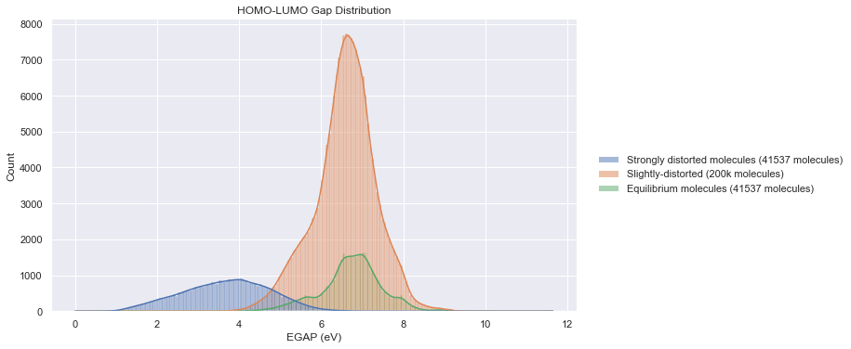
Data Distribution

Slide 12
Neural Networks
Architectures used:
Using only geometric molecular descriptors.
Using Geometric Descriptors and DFTB properties concatenated for input layer
Using separate models for Geometric Descriptors and DFTB properties
Property Predicted: Atomization Energy
Total feature size of DFTB properties: 40
Total feature size of molecular descriptors:
Coulomb Matrix: 276
BOB: 528
SLATM: 17935
Feature Selection was done to select the most relevant properties for training the model (Under Progress)

Slide 13
Results

Slide 14
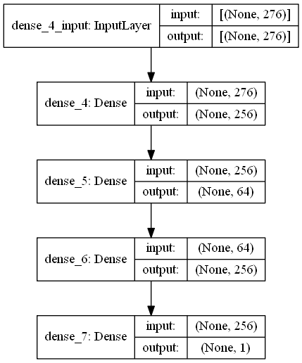
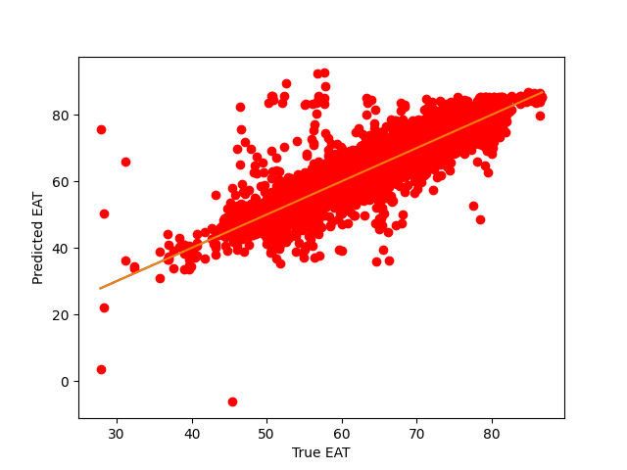
Architecture-1
Sequential Neural Network with only geometric descriptors (Coulomb Matrix)​ as input
Training size: 30,000, validation size: 1,000; test size: 10,000​
Using Non-Equilibrium Molecules​
Test error: 0.711 eV = 16.39 kcal/mol​

Slide 15
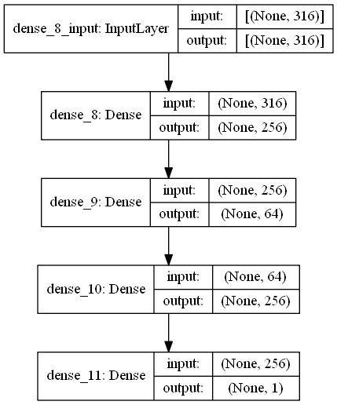
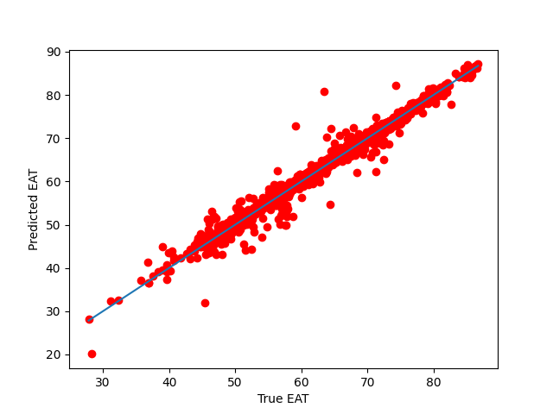
Architecture-2
Sequential Neural Network with Coulomb Matrix and DFTB properties concatenated for the input layer.​
Training size of 30,000, Validation size: 1,000; Test size: 10,000​
Using Non-Equilibrium Molecules​
Test error = 0.39 eV = 9 kcal/mol​
Notes:
Mention that funnel based approach did not give better results

Slide 16
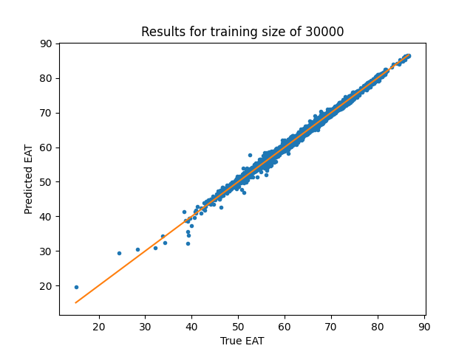
Architecture-2 – With Standardization
Training size: 30,000; validation size: 1,000; test size: 10,000 – Non-Equilibrium dataset
Data standardization of DFTB properties.
Sequential Neural Network with Molecular Descriptors and DFTB properties concatenated for the input layer
Test error = 0.35 eV = 8.07 kcal/mol​
Notes:
Using funnel based approach

Slide 17
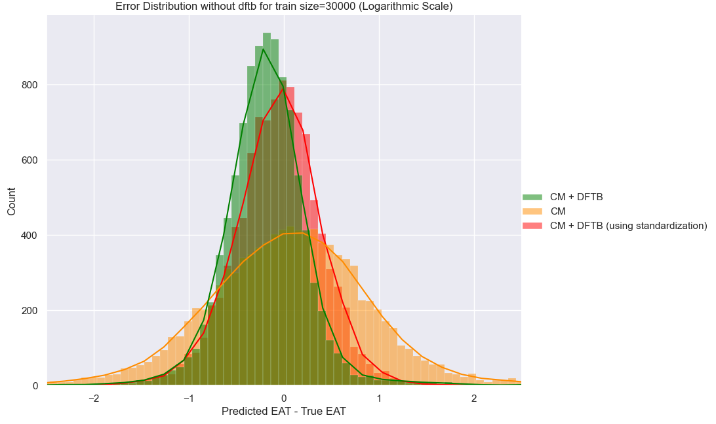
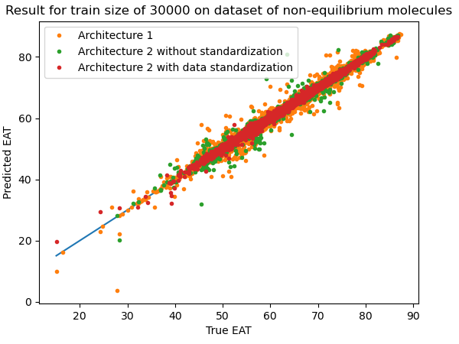
Architecture-Comparison

Slide 18
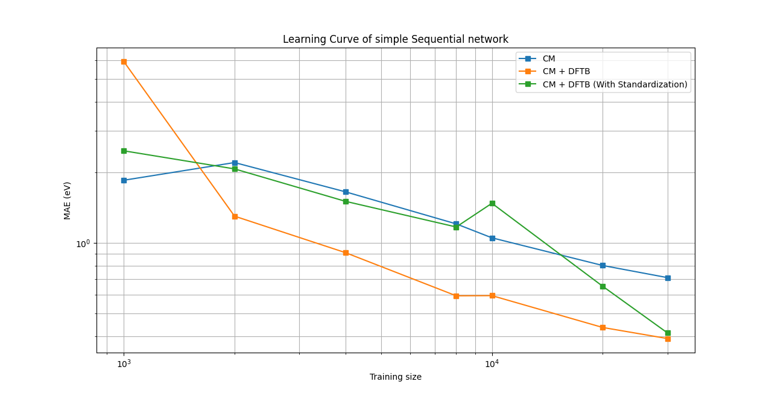
Architecture-Comparison
Both axes are in logarithmic scale

Slide 19
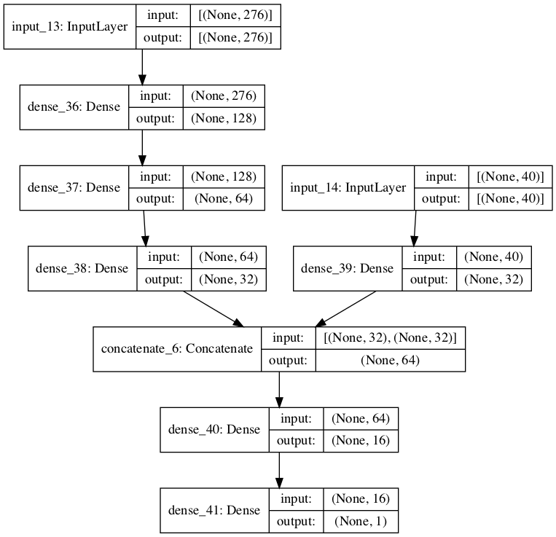
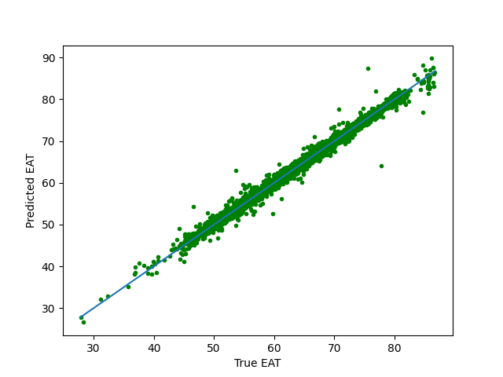
Architecture 3: Using 2 separate models followed by concatenation Final error: 0.4132 eV = 9.53 kcal/mol

Slide 20
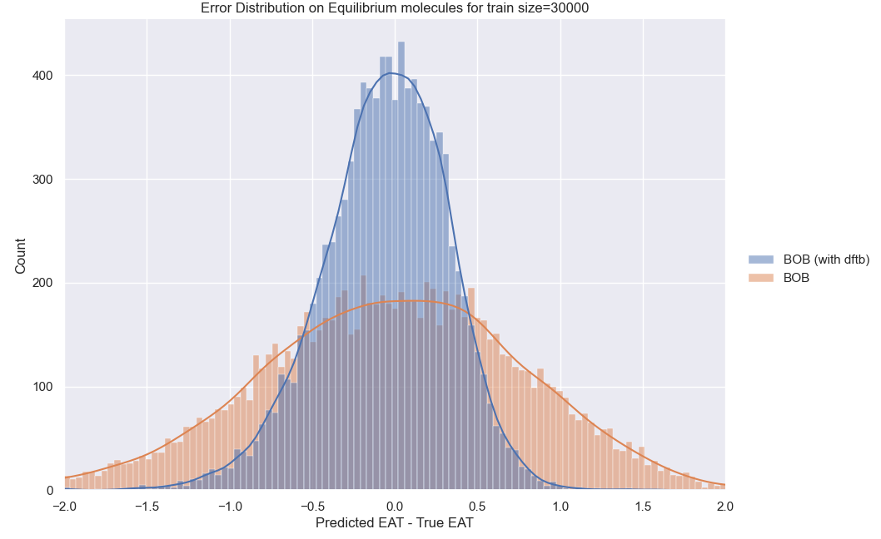
Sequential Model Using BOB (Bag of Bonds)
Shape of input layer: 528+40 = 568
Non-Equilibrium molecules
Test error for training size of 30000
BOB = 0.6421 eV = 14.806
(BOB+DFTB) = 0.302 eV = 6.96 kcal/mol

Slide 21
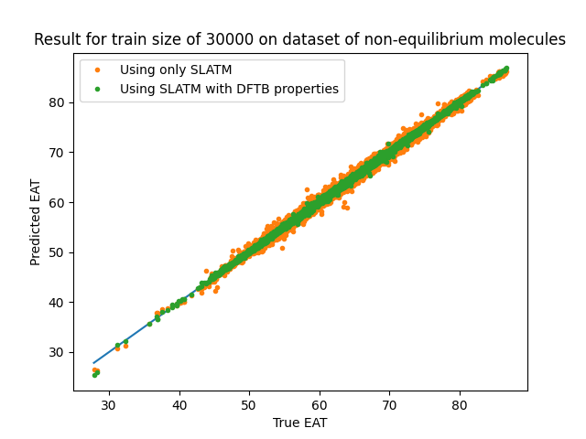
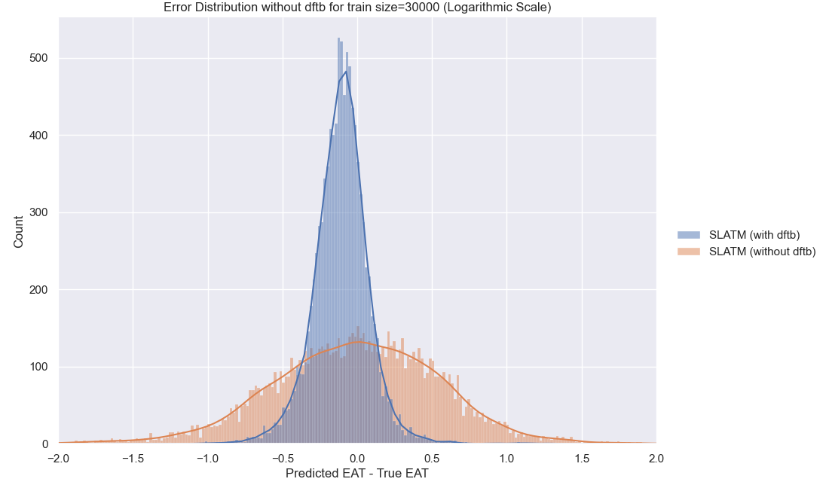
SLATM
Distorted Dataset:
Train_set=30000
Val_set=1000
Test_set=10000
MAE: Using DFTB = 0.16494 eV = 3.803 kcal/mol
Using only SLATM = 0.446 eV = 10.2847 kcal/mol

Slide 22
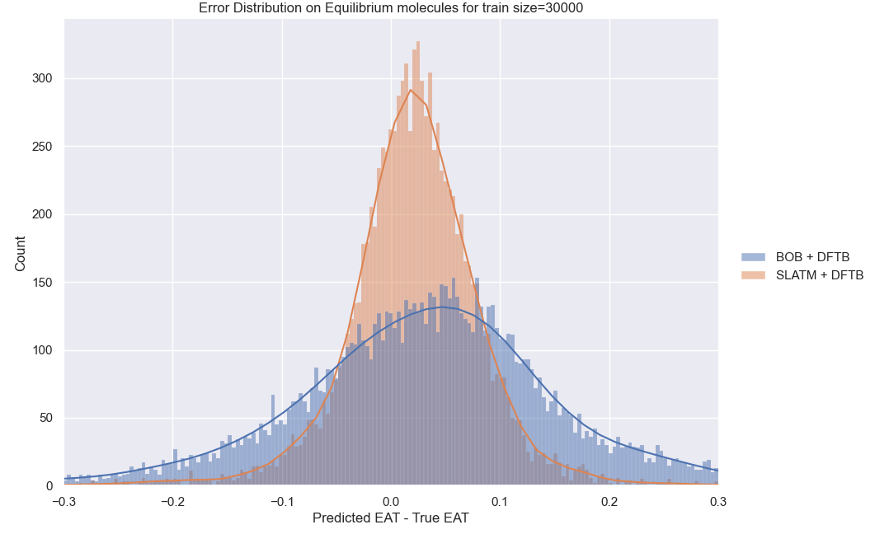
Equilibrium Dataset
Equilibrium Dataset:
Train_set=30000
Val_set=1000
Test_set=10000
MAE:
SLATM+DFTB: 0.0498 eV = 1.148 kcal/mol
BOB + DFTB: 0.1065 eV = 2.456 kcal/mol

Slide 23
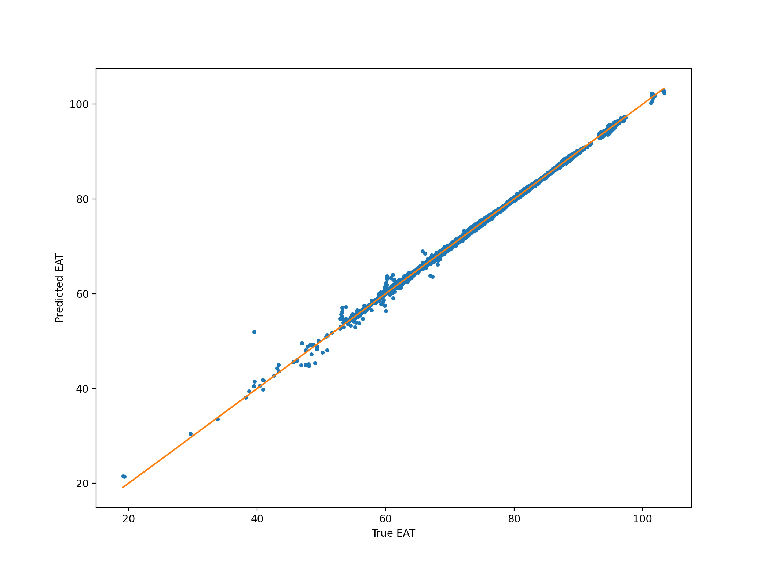
Architecture 2 on Dataset of Using slightly distorted molecules
Output with training size of 50,000, validation size 5,000, test size of 200000
Test error = 0.1712 eV = 3.94 kcal/mol

Slide 24
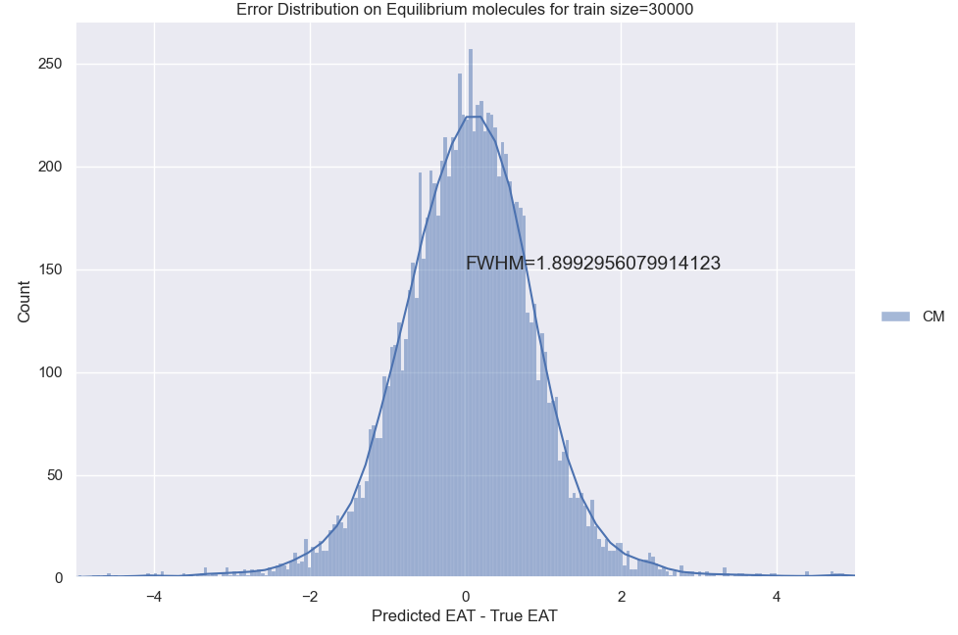
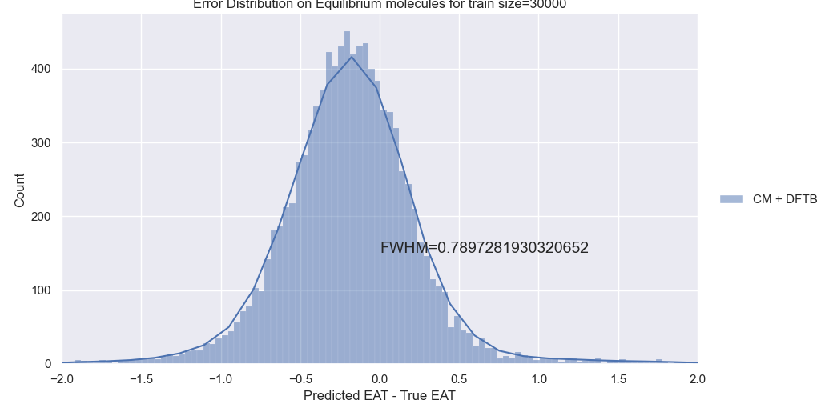
Standard Deviation on Distorted Molecules
 | CM | CM + DFTB | SLATM | SLATM+DFTB | BOB + DFTB
Std Dev: | 0.7048 | 0.4492 | 0.577 | 0.195 | 0.384

Slide 25
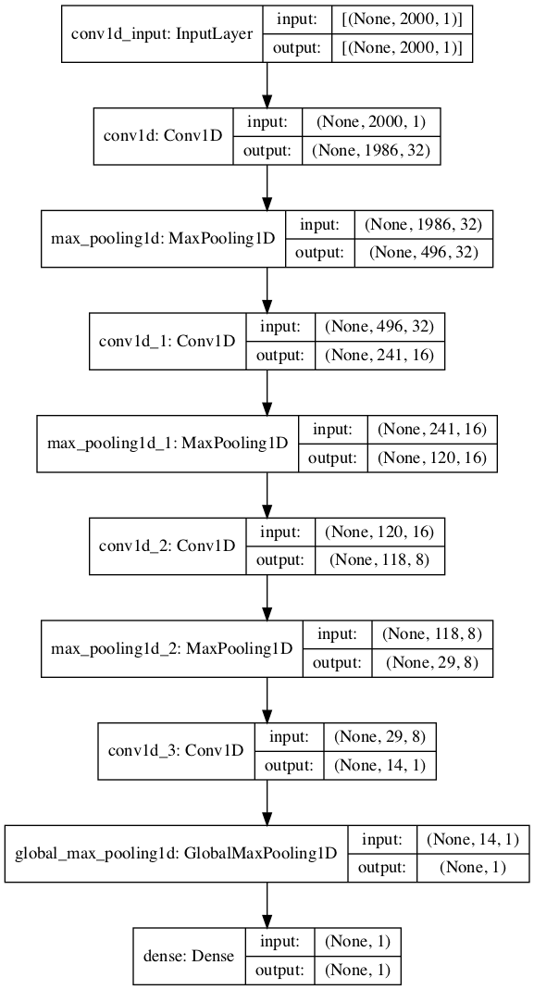
Using Kernel
Test error (with the train kernel)= 5.82 eV
Test error (after using alpha) = 4.56 eV

Slide 26
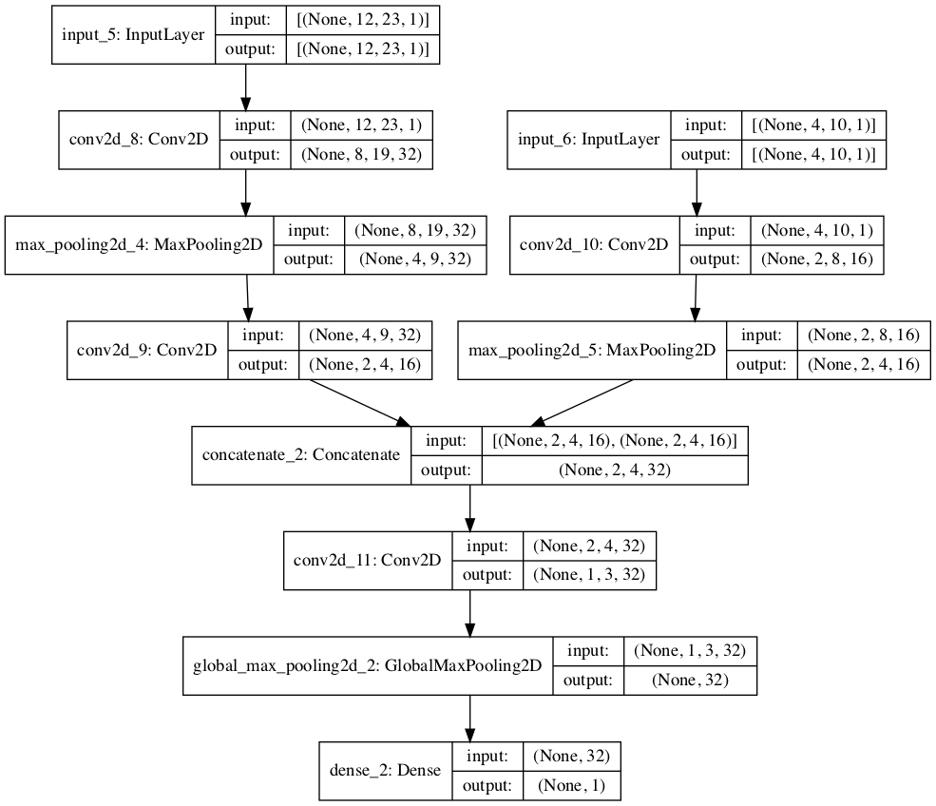
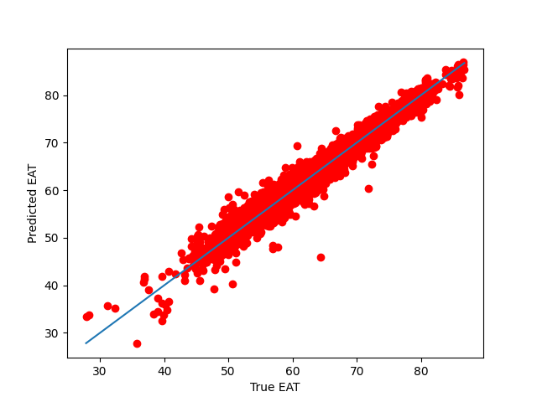
CNN – Failed Model Final error: 6.88 eV

Slide 27
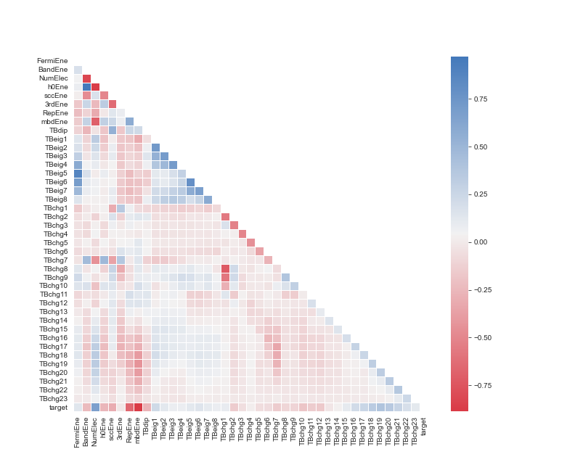
Feature Selection

Slide 28
Train set | None | FermiEne | BandEne | NumElec | h0Ene | sccEne | 3rdEne | RepEne | mbdEne | TBdip
1000 | 1.882 | 1.885 | 2.047 | 5.810 | 2.412 | 1.999 | 1.891 | 3.08 | 1.924 | 1.895
4000 | 0.59 | 0.702 | 0.687 | 22.34 | 23.614 | 0.738 | 0.624 | 3.606 | 1.022 | 0.595
8000 | 0.348 | 0.5416 | 0.4004 | 24.352 | 19.983 | 0.530 | 0.370 | 3.016 | 0.578 | 0.350
30000 | 0.3425 | 0.451 | 0.717 | 22.87 | 25.98 | 0.509 | 0.347 | 4.42 | 0.644 | 0.349
Using pre-trained model of Architecture-2 (CM+DFTB) with standardization
Shuffle each property randomly
Test the model on shuffled set

Slide 29
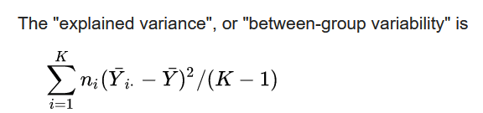
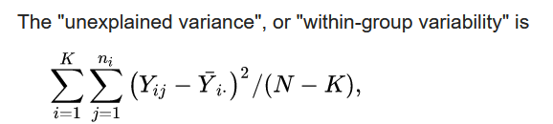
Correlation Scores
 | FermiEne | BandEne | NumElec | h0Ene | SccEne | 3rd Ene | Rep Ene | Mbd Ene | TbDip
 | 1.728 | 2.039 | 3.92 | 2.353 | 2.37 | 2.002 | 4.796 | 8.813 | 1.561
F-classif -> ANOVA f-values: Denoting the correlation of these properties with Atomization Energy
F = (Explained Variance)/(Unexplained Variance)
Yi = Samples of ith group
n_{i} = is the number of observations in the i-th group
K = Number of groups

Slide 30
RFE – Recursive Feature Elimination
Select 4 features: NumElec, h0Ene, Rep Ene, MbdEne
Using: DecisionTreeRegressor
Rank of Remaining features:​
SccEne– 2nd​
FermiEne – 3rd ​
Band Ene – 4th ​
3rd Ene– 5th ​
Dipole Moment – 6th

Slide 31
RFE – Recursive Feature Elimination
Property Removed | Test Error (MAE, eV)
None | 0.5909
Fermi Energy | 0.897
Band Energy | 0.535
Number of Electrons | 0.7198
0th Energy | 0.629
Scc Energy | 0.5615
3rd Energy | 0.5623
Rep Energy | 0.6028
Mbd Energy | 0.5719
Dipole Moment | 0.3598
Eigen Values | 0.543
Charges | 0.653
Training size: 10000
Epochs: 8000
Recursively, properties were eliminated, and models were trained

Slide 32
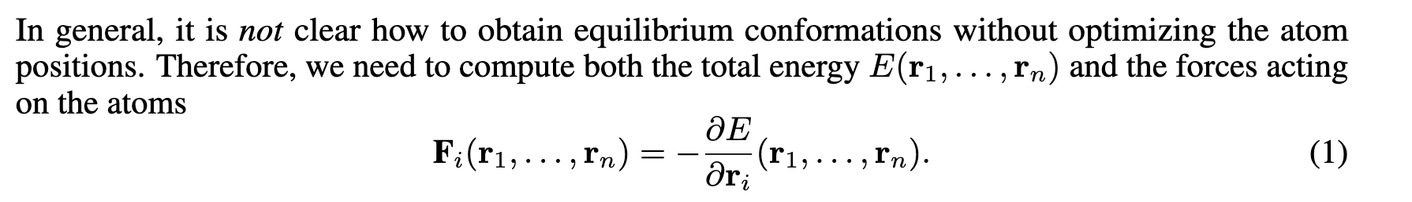
Forces
Fp = -tf.gradients(tf.reduce_sum(Ep), atoms_input[1])[0]

Slide 33
Challenges and Future Work
Finishing the existing work of Feature Selection and Prediction of HOMO-LUMO gap.
Developing Machine Learning Force Fields using geometric and DFTB representations
Using Neural Network Representations as inputs for the model.
Final Thesis Submission: 20th December

